Slide 1
Basic Text Processing
Regular Expressions

Slide 2
Regular Expressions: Negation in Disjunction
Negations [^Ss]
Carat means negation only when first in []
Pattern | Matches
[^A-Z] | Not an upper case letter | Oyfn pripetchik
[^Ss] | Neither ‘S’ nor ‘s’ | I have no exquisite reason”
[^e^] | Neither e nor ^ | Look here
a^b | The pattern a carat b | Look up a^b now

Slide 3
Role of Regular Expressions
Regular expressions play a surprisingly large role
Sophisticated sequences of regular expressions are often the first model for any text processing text
For many hard tasks, we use machine learning classifiers
But regular expressions are used as features in the classifiers
Can be very useful in capturing generalizations

Slide 4
Hearst Patterns
In her seminal 1992 paper, entitled Automatic Acquisition of Hyponyms from Large Text Corpora, Marti Hearst defined a set of patterns for identifying hypernym/hyponym relations (also known as is-a)
The bow lute, such as the Bambara ndang, is plucked and has an individual curved neck for each string

Slide 6
Unix utility: grep
zcat * | grep " such as " | more
zcat * | grep " and other " | more
management consultants such as McKinsey and CSC Index.
social evils such as prostitution, drug addiction and HIV
new set of potentially lucrative services, such as movies on demand
the students use canned chicken broth such as Swanson's
in treating medical conditions such as psoriasis, seasonal
sanitation problems, the endless red tape and other difficulties
Court records and other documents show that Angela Tene
providing dominoes, card games and other recreation to help asylum
malls, swap meets, colleges, barber shops and other popular haunts
Notes:
ssh nlpgrid.seas.upenn.edu
qlogin
cd /nlp/data/corpora/LDC/LDC2003T05/nyt
zcat * | grep " such as " | more

Slide 7
Basic Text Processing
Word tokenization

Slide 8
Text Normalization
Every NLP task needs to do text normalization:
Segmenting/tokenizing words in running text
Normalizing word formats
Segmenting sentences in running text

Slide 9
How many words?
I do uh main- mainly business data processing
Fragments, filled pauses
Seuss’s cat in the hat is different from other cats!
Lemma: same stem, part of speech, rough word sense
cat and cats = same lemma
Wordform: the full inflected surface form
cat and cats = different wordforms

Slide 10
How many words?
they lay back on the San Francisco grass and looked at the stars and their
Type: an element of the vocabulary.
Token: an instance of that type in running text.
How many?
15 tokens (or 14)
13 types (or 12) (or 11?)
Notes:
Should San Francisco be considered 1 or 2 words?
'the’ is repeated twice
So is ’and’
Should they and their be collaposed to the same lemma?

Slide 11
How many words?
N = number of tokens
V = vocabulary = set of types
|V| is the size of the vocabulary
Church and Gale (1990): |V| > O(N^{½})
 | Tokens = N | Types = |V|
Switchboard phone conversations | 2.4 million | 20 thousand
Shakespeare | 884,000 | 31 thousand
Google N-grams | 1 trillion | 13 million

Slide 12
Simple Tokenization in UNIX
(Inspired by Ken Church’s UNIX for Poets.)
Given a text file, output the word tokens and their frequencies
tr -sc ’A-Za-z’ ’\n’ < shakes.txt
| sort
| uniq –c
1945 A
72 AARON
19 ABBESS
5 ABBOT
... ...
Change all non-alpha to newlines
Sort in alphabetical order
Merge and count each type
25 Aaron
6 Abate
1 Abates
5 Abbess
6 Abbey
3 Abbot
.... …
Notes:
tr = translate characters

Slide 13
The first step: tokenizing
tr -sc ’A-Za-z’ ’\n’ < shakes.txt | head
THE
SONNETS
by
William
Shakespeare
From
fairest
creatures
We
...

Slide 14
The second step: sorting
tr -sc ’A-Za-z’ ’\n’ < shakes.txt | sort | head
A
A
A
A
A
A
A
A
A
...

Slide 15
More counting
Merging upper and lower case
tr ‘A-Z’ ‘a-z’ < shakes.txt | tr –sc ‘A-Za-z’ ‘\n’ | sort | uniq –c
Sorting the counts
tr ‘A-Z’ ‘a-z’ < shakes.txt | tr –sc ‘A-Za-z’ ‘\n’ | sort | uniq –c | sort –n –r
23243 the
22225 i
18618 and
16339 to
15687 of
12780 a
12163 you
10839 my
10005 in
8954 d
What happened here?
Notes:
call'd me

Slide 16
Issues in Tokenization
Finland’s capital → Finland Finlands Finland’s ?
what’re, I’m, isn’t → What are, I am, is not
Hewlett-Packard → Hewlett Packard ?
state-of-the-art → state of the art ?
Lowercase → lower-case lowercase lower case ?
San Francisco → one token or two?
m.p.h., PhD. → ??

Slide 17
Tokenization: language issues
French
L'ensemble → one token or two?
L ? L’ ? Le ?
Want l’ensemble to match with un ensemble
German noun compounds are not segmented
Lebensversicherungsgesellschaftsangestellter
‘life insurance company employee’
German information retrieval needs compound splitter

Slide 18
Tokenization: language issues
Chinese and Japanese no spaces between words:
莎拉波娃现在居住在美国东南部的佛罗里达。
莎拉波娃 现在 居住 在 美国 东南部 的 佛罗里达
Sharapova now lives in US southeastern Florida
Further complicated in Japanese, with multiple alphabets intermingled
Dates/amounts in multiple formats
フォーチュン500社は情報不足のため時間あた$500K(約6,000万円)
Katakana
Hiragana
Kanji
Romaji
End-user can express query entirely in hiragana!

Slide 19
Word Tokenization in Chinese
Also called Word Segmentation
Chinese words are composed of characters
Characters are generally 1 syllable and 1 morpheme.
Average word is 2.4 characters long.
Standard baseline segmentation algorithm:
Maximum Matching (also called Greedy)

Slide 20
Maximum Matching Word Segmentation Algorithm
Given a wordlist of Chinese, and a string.
Start a pointer at the beginning of the string
Find the longest word in dictionary that matches the string starting at pointer
Move the pointer over the word in string
Go to 2

Slide 21
Max-match segmentation illustration
Thecatinthehat
Thetabledownthere
Doesn’t generally work in English!
But works astonishingly well in Chinese
莎拉波娃现在居住在美国东南部的佛罗里达。
莎拉波娃 现在 居住 在 美国 东南部 的 佛罗里达
Modern probabilistic segmentation algorithms even better
the cat in the hat
the table down there
theta bled own there

Slide 22
Basic Text Processing
Word tokenization

Slide 23
Basic Text Processing
Word Normalization and Stemming

Slide 24
Normalization
Need to “normalize” terms
Information Retrieval: indexed text & query terms must have same form.
We want to match U.S.A. and USA
We implicitly define equivalence classes of terms
e.g., deleting periods in a term
Alternative: asymmetric expansion:
Enter: window Search: window, windows
Enter: windows Search: Windows, windows, window
Enter: Windows Search: Windows
Potentially more powerful, but less efficient

Slide 25
Case folding
Applications like IR: reduce all letters to lower case
Since users tend to use lower case
Possible exception: upper case in mid-sentence?
e.g., General Motors
Fed vs. fed
SAIL vs. sail
For sentiment analysis, MT, Information extraction
Case is helpful (US versus us is important)

Slide 26
Lemmatization
Reduce inflections or variant forms to base form
am, are, is → be
car, cars, car's, cars' → car
the boy's cars are different colors → the boy car be different color
Lemmatization: have to find correct dictionary headword form
Machine translation
Spanish quiero (‘I want’), quieres (‘you want’) same lemma as querer ‘want’

Slide 27
Morphology
Morphemes:
The small meaningful units that make up words
Stems: The core meaning-bearing units
Affixes: Bits and pieces that adhere to stems
Often with grammatical functions

Slide 28
Stemming
Reduce terms to their stems in information retrieval
Stemming is crude chopping of affixes
language dependent
e.g., automate(s), automatic, automation all reduced to automat.
for example compressed
and compression are both
accepted as equivalent to
compress.
for exampl compress and
compress ar both accept
as equival to compress

Slide 29
Porter’s algorithm The most common English stemmer
Step 1a
sses → ss caresses → caress
ies → i ponies → poni
ss → ss caress → caress
s → ø cats → cat
Step 1b
(*v*)ing → ø walking → walk
sing → sing
(*v*)ed → ø plastered → plaster
…
Step 2 (for long stems)
ational→ ate relational→ relate
izer→ ize digitizer → digitize
ator→ ate operator → operate
…
Step 3 (for longer stems)
al → ø revival → reviv
able → ø adjustable → adjust
ate → ø activate → activ
…

Slide 30
Viewing morphology in a corpus Why only strip –ing if there is a vowel?
(*v*)ing → ø walking → walk
sing → sing

Slide 31
Viewing morphology in a corpus Why only strip –ing if there is a vowel?
(*v*)ing → ø walking → walk
sing → sing
tr -sc 'A-Za-z' '\n' < shakes.txt | grep ’ing$' | sort | uniq -c | sort –nr
tr -sc 'A-Za-z' '\n' < shakes.txt | grep '[aeiou].*ing$' | sort | uniq -c | sort –nr
1312 King
548 being
541 nothing
388 king
375 bring
358 thing
307 ring
152 something
145 coming
130 morning
548 being
541 nothing
152 something
145 coming
130 morning
122 having
120 living
117 loving
116 Being
102 going

Slide 32
Dealing with complex morphology is sometimes necessary
Some languages requires complex morpheme segmentation
Turkish
Uygarlastiramadiklarimizdanmissinizcasina
`(behaving) as if you are among those whom we could not civilize’
Uygar `civilized’ + las `become’
+ tir `cause’ + ama `not able’
+ dik `past’ + lar ‘plural’
+ imiz ‘p1pl’ + dan ‘abl’
+ mis ‘past’ + siniz ‘2pl’ + casina ‘as if’
Notes:
Good description for President Trump.

Slide 33
Basic Text Processing
Word Normalization and Stemming

Slide 34
Basic Text Processing
Sentence Segmentation and Decision Trees

Slide 35
Sentence Segmentation
!, ? are relatively unambiguous
Period “.” is quite ambiguous
Sentence boundary
Abbreviations like Inc. or Dr.
Numbers like .02% or 4.3
Build a binary classifier
Looks at a “.”
Decides EndOfSentence/NotEndOfSentence
Classifiers: hand-written rules, regular expressions, or machine-learning

Slide 36
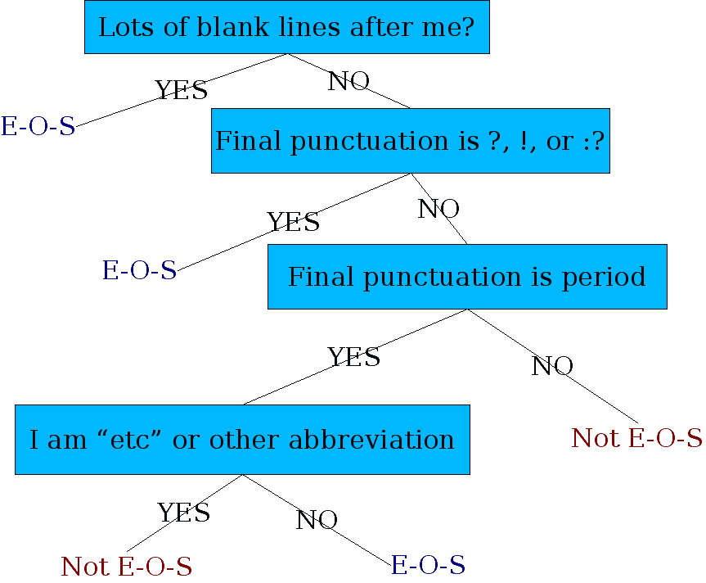
Determining if a word is end-of-sentence: a Decision Tree

Slide 37
More sophisticated decision tree features
Case of word with “.”: Upper, Lower, Cap, Number
Case of word after “.”: Upper, Lower, Cap, Number
Numeric features
Length of word with “.”
Probability(word with “.” occurs at end-of-s)
Probability(word after “.” occurs at beginning-of-s)

Slide 38
Implementing Decision Trees
A decision tree is just an if-then-else statement
The interesting research is choosing the features
Setting up the structure is often too hard to do by hand
Hand-building only possible for very simple features, domains
For numeric features, it’s too hard to pick each threshold
Instead, structure usually learned by machine learning from a training corpus

Slide 39
Decision Trees and other classifiers
We can think of the questions in a decision tree
As features that could be exploited by any kind of classifier
Logistic regression
SVM
Neural Nets
etc.

Slide 40
Language Modeling
Introduction to N-grams

Slide 41
Probabilistic Language Models
Today’s goal: assign a probability to a sentence
Machine Translation:
P(high winds tonite) > P(large winds tonite)
Spelling Correction
The office is about fifteen minuets from my house
P(about fifteen minutes from) > P(about fifteen minuets from)
Speech Recognition
P(I saw a van) >> P(eyes awe of an)
+ Summarization, question-answering, etc., etc.!!
Why?
Notes:
minuet = a slow, stately ballroom dance

Slide 42
Probabilistic Language Modeling
Goal: compute the probability of a sentence or sequence of words:
P(W) = P(w₁,w₂,w₃,w₄,w₅…w_{n})
Related task: probability of an upcoming word:
P(w₅|w₁,w₂,w₃,w₄)
A model that computes either of these:
P(W) or P(w_{n}|w₁,w₂…w_{n-1}) is called a language model.
Better: the grammar But language model or LM is standard

Slide 43
How to compute P(W)
How to compute this joint probability:
P(its, water, is, so, transparent, that)
Intuition: let’s rely on the Chain Rule of Probability

Slide 44
Reminder: The Chain Rule
Recall the definition of conditional probabilities
p(B|A) = P(A,B)/P(A) Rewriting: P(A,B) = P(A)P(B|A)
More variables:
P(A,B,C,D) = P(A)P(B|A)P(C|A,B)P(D|A,B,C)
The Chain Rule in General
P(x₁,x₂,x₃,…,x_{n}) = P(x₁)P(x₂|x₁)P(x₃|x₁,x₂)…P(x_{n}|x₁,…,x_{n-1})

Slide 45
The Chain Rule applied to compute joint probability of words in sentence
P(“its water is so transparent”) =
P(its) × P(water|its) × P(is|its water)
× P(so|its water is) × P(transparent|its water is so)

Slide 46
How to estimate these probabilities
Could we just count and divide?
No! Too many possible sentences!
We’ll never see enough data for estimating these

Slide 47

Markov Assumption
Simplifying assumption:
Or maybe
Andrei Markov

Slide 48
Markov Assumption
In other words, we approximate each component in the product

Slide 49
Simplest case: Unigram model
Some automatically generated sentences from a unigram model
fifth, an, of, futures, the, an, incorporated, a, a, the, inflation, most, dollars, quarter, in, is, mass
thrift, did, eighty, said, hard, 'm, july, bullish
that, or, limited, the

Slide 50
Bigram model
Condition on the previous word:
texaco, rose, one, in, this, issue, is, pursuing, growth, in, a, boiler, house, said, mr., gurria, mexico, 's, motion, control, proposal, without, permission, from, five, hundred, fifty, five, yen
outside, new, car, parking, lot, of, the, agreement, reached
this, would, be, a, record, november

Slide 51
N-gram models
We can extend to trigrams, 4-grams, 5-grams
In general this is an insufficient model of language
because language has long-distance dependencies:
“The computer(s) which I had just put into the machine room on the fifth floor is (are) crashing.”
But we can often get away with N-gram models

Slide 52
Language Modeling
Introduction to N-grams

Slide 53
Language Modeling
Estimating N-gram Probabilities

Slide 54
Estimating bigram probabilities
The Maximum Likelihood Estimate

Slide 55
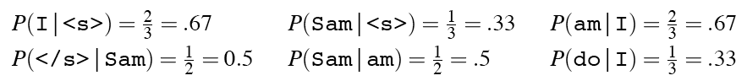
An example
<s> I am Sam </s>
<s> Sam I am </s>
<s> I do not like green eggs and ham </s>

Slide 56
More examples: Berkeley Restaurant Project sentences
can you tell me about any good cantonese restaurants close by
mid priced thai food is what i’m looking for
tell me about chez panisse
can you give me a listing of the kinds of food that are available
i’m looking for a good place to eat breakfast
when is caffe venezia open during the day

Slide 57
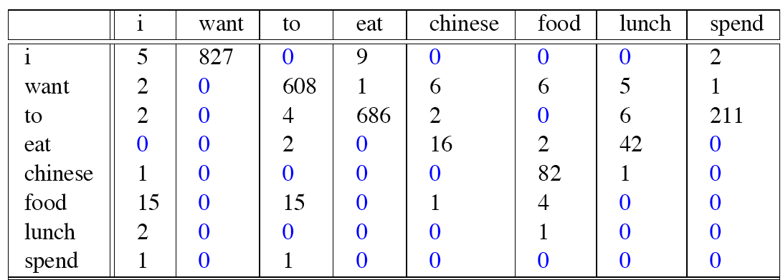
Raw bigram counts
Out of 9222 sentences

Slide 58
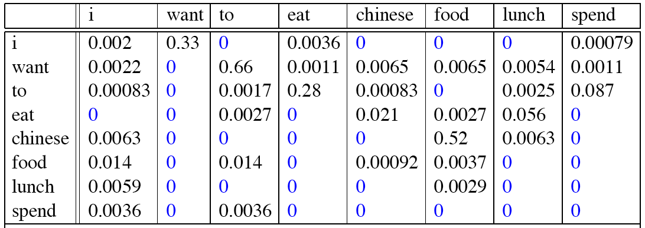
Raw bigram probabilities
Normalize by unigrams:
Result:

Slide 59
Bigram estimates of sentence probabilities
P(<s> I want english food </s>) =
P(I|<s>)
× P(want|I)
× P(english|want)
× P(food|english)
× P(</s>|food)
= .000031

Slide 60
What kinds of knowledge?
P(english|want) = .0011
P(chinese|want) = .0065
P(to|want) = .66
P(eat | to) = .28
P(food | to) = 0
P(want | spend) = 0
P (i | <s>) = .25

Slide 61
Practical Issues
We do everything in log space
Avoid underflow
(also adding is faster than multiplying)

Slide 62
Language Modeling Toolkits
SRILM
http://www.speech.sri.com/projects/srilm/
KenLM
https://kheafield.com/code/kenlm/

Slide 63
Google N-Gram Release, August 2006
…

Slide 64
Google N-Gram Release
serve as the incoming 92
serve as the incubator 99
serve as the independent 794
serve as the index 223
serve as the indication 72
serve as the indicator 120
serve as the indicators 45
serve as the indispensable 111
serve as the indispensible 40
serve as the individual 234
http://googleresearch.blogspot.com/2006/08/all-our-n-gram-are-belong-to-you.html

Slide 65
Google Book N-grams
http://ngrams.googlelabs.com/

Slide 66
Language Modeling
Estimating N-gram Probabilities

Slide 67
Language Modeling
Evaluation and Perplexity

Slide 68
Evaluation: How good is our model?
Does our language model prefer good sentences to bad ones?
Assign higher probability to “real” or “frequently observed” sentences
Than “ungrammatical” or “rarely observed” sentences?
We train parameters of our model on a training set.
We test the model’s performance on data we haven’t seen.
A test set is an unseen dataset that is different from our training set, totally unused.
An evaluation metric tells us how well our model does on the test set.

Slide 69
Training on the test set
We can’t allow test sentences into the training set
We will assign it an artificially high probability when we set it in the test set
“Training on the test set”
Bad science!
And violates the honor code

Slide 70
Extrinsic evaluation of N-gram models
Best evaluation for comparing models A and B
Put each model in a task
spelling corrector, speech recognizer, MT system
Run the task, get an accuracy for A and for B
How many misspelled words corrected properly
How many words translated correctly
Compare accuracy for A and B

Slide 71
Difficulty of extrinsic (in-vivo) evaluation of N-gram models
Extrinsic evaluation
Time-consuming; can take days or weeks
So
Sometimes use intrinsic evaluation: perplexity
Bad approximation
unless the test data looks just like the training data
So generally only useful in pilot experiments
But is helpful to think about.

Slide 72
Intuition of Perplexity
mushrooms 0.1
pepperoni 0.1
anchovies 0.01
….
fried rice 0.0001
….
and 1e-100
The Shannon Game:
How well can we predict the next word?
Unigrams are terrible at this game. (Why?)
A better model of a text
is one which assigns a higher probability to the word that actually occurs
I always order pizza with cheese and ____
The 33rd President of the US was ____
I saw a ____

Slide 73
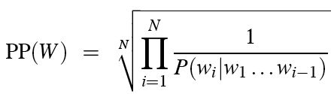
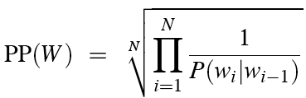
Perplexity
The best language model is one that best predicts an unseen test set
Gives the highest P(sentence)
Perplexity is the inverse probability of the test set, normalized by the number of words:
Chain rule:
For bigrams:
Minimizing perplexity is the same as maximizing probability

Slide 74
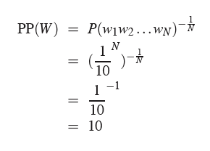
Perplexity as branching factor
Let’s suppose a sentence consisting of random digits
What is the perplexity of this sentence according to a model that assign P=1/10 to each digit?

Slide 75
Lower perplexity = better model
Training 38 million words, test 1.5 million words, WSJ
N-gram Order | Unigram | Bigram | Trigram
Perplexity | 962 | 170 | 109

Slide 76
Language Modeling
Evaluation and Perplexity

Slide 77
Language Modeling
Generalization and zeros

Slide 78
The Shannon Visualization Method
Choose a random bigram
(<s>, w) according to its probability
Now choose a random bigram (w, x) according to its probability
And so on until we choose </s>
Then string the words together
<s> I
I want
want to
to eat
eat Chinese
Chinese food
food </s>
I want to eat Chinese food

Slide 79
Approximating Shakespeare

Slide 80
Shakespeare as corpus
N=884,647 tokens, V=29,066
Shakespeare produced 300,000 bigram types out of V²= 844 million possible bigrams.
So 99.96% of the possible bigrams were never seen (have zero entries in the table)
Quadrigrams worse: What's coming out looks like Shakespeare because it is Shakespeare

Slide 81
The wall street journal is not shakespeare (no offense)

Slide 82
Can you guess the author of these random 3-gram sentences?
They also point to ninety nine point six billion dollars from two hundred four oh six three percent of the rates of interest stores as Mexico and gram Brazil on market conditions
This shall forbid it should be branded, if renown made it empty.
“You are uniformly charming!” cried he, with a smile of associating and now and then I bowed and they perceived a chaise and four to wish for.

Slide 83
The perils of overfitting
N-grams only work well for word prediction if the test corpus looks like the training corpus
In real life, it often doesn’t
We need to train robust models that generalize!
One kind of generalization: Zeros!
Things that don’t ever occur in the training set
But occur in the test set

Slide 84
Zeros
Training set:
… denied the allegations
… denied the reports
… denied the claims
… denied the request
P(“offer” | denied the) = 0
Test set
… denied the offer
… denied the loan

Slide 85
Zero probability bigrams
Bigrams with zero probability
mean that we will assign 0 probability to the test set!
And hence we cannot compute perplexity (can’t divide by 0)!

Slide 86
Language Modeling
Generalization and zeros

Slide 87
Language Modeling
Smoothing: Add-one (Laplace) smoothing

Slide 88
The intuition of smoothing (from Dan Klein)
When we have sparse statistics:
Steal probability mass to generalize better
P(w | denied the)
3 allegations
2 reports
1 claims
1 request
7 total
allegations
attack
man
reports
outcome
…
claims
request
P(w | denied the)
2.5 allegations
1.5 reports
0.5 claims
0.5 request
2 other
7 total
allegations
allegations
attack
man
outcome
reports
…
claims
request

Slide 89
Add-one estimation
Also called Laplace smoothing
Pretend we saw each word one more time than we did
Just add one to all the counts!
MLE estimate:
Add-1 estimate:

Slide 90
Maximum Likelihood Estimates
The maximum likelihood estimate
of some parameter of a model M from a training set T
maximizes the likelihood of the training set T given the model M
Suppose the word “bagel” occurs 400 times in a corpus of a million words
What is the probability that a random word from some other text will be “bagel”?
MLE estimate is 400/1,000,000 = .0004
This may be a bad estimate for some other corpus
But it is the estimate that makes it most likely that “bagel” will occur 400 times in a million word corpus.

Slide 91
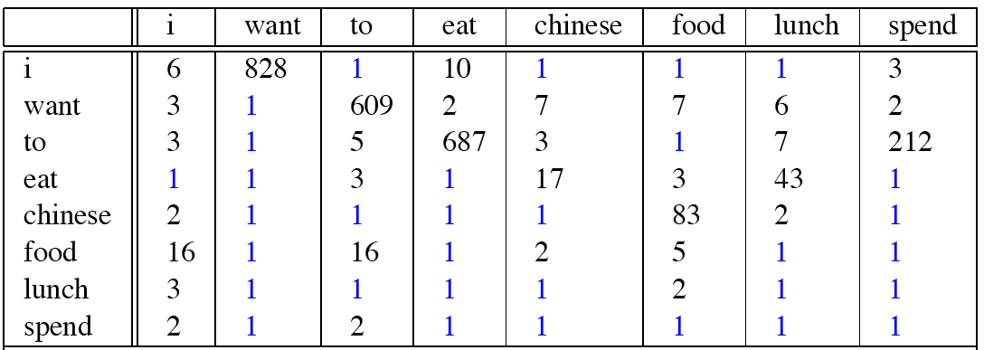
Berkeley Restaurant Corpus: Laplace smoothed bigram counts

Slide 92
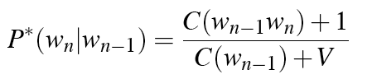
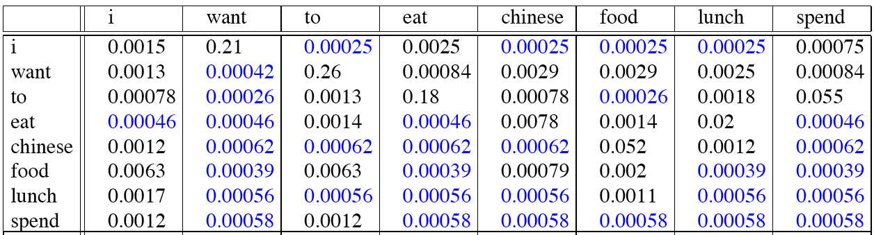
Laplace-smoothed bigrams

Slide 93
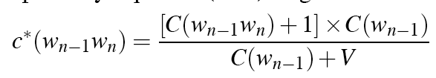
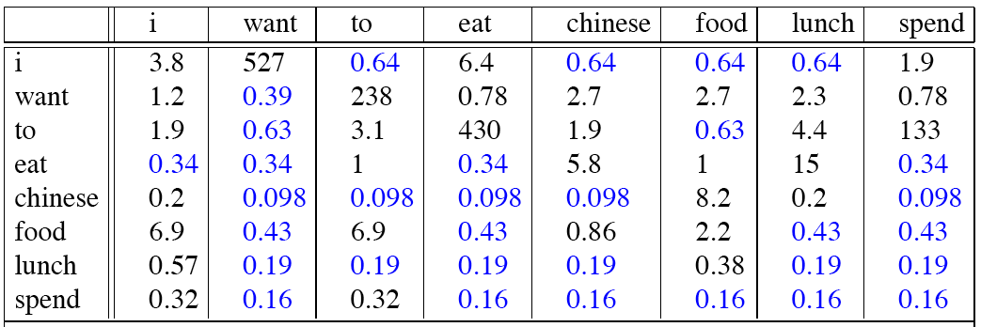
Reconstituted counts

Slide 94
Compare with raw bigram counts
Notes:
C(want to) went from 608 to 238, P(to|want) from .66 to .26!
Discount d= c*/c
d for “chinese food” =.10!!! A 10x reduction

Slide 95
Add-1 estimation is a blunt instrument
So add-1 isn’t used for N-grams:
We’ll see better methods
But add-1 is used to smooth other NLP models
For text classification
In domains where the number of zeros isn’t so huge.

Slide 96
Language Modeling
Smoothing: Add-one (Laplace) smoothing

Slide 97
Language Modeling
Interpolation, Backoff, and Web-Scale LMs

Slide 98
Backoff and Interpolation
Sometimes it helps to use less context
Condition on less context for contexts you haven’t learned much about
Backoff:
use trigram if you have good evidence,
otherwise bigram, otherwise unigram
Interpolation:
mix unigram, bigram, trigram
Interpolation works better

Slide 99
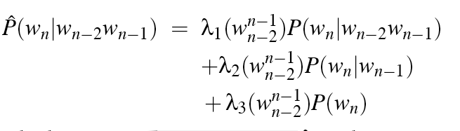
Linear Interpolation
Simple interpolation
Lambdas conditional on context:

Slide 100
How to set the lambdas?
Use a held-out corpus
Choose λs to maximize the probability of held-out data:
Fix the N-gram probabilities (on the training data)
Then search for λs that give largest probability to held-out set:
Training Data
Held-Out Data
Test
Data

Slide 101
Unknown words: Open versus closed vocabulary tasks
If we know all the words in advanced
Vocabulary V is fixed
Closed vocabulary task
Often we don’t know this
Out Of Vocabulary = OOV words
Open vocabulary task
Instead: create an unknown word token <UNK>
Training of <UNK> probabilities
Create a fixed lexicon L of size V
At text normalization phase, any training word not in L changed to <UNK>
Now we train its probabilities like a normal word
At decoding time
If text input: Use UNK probabilities for any word not in training

Slide 102
Huge web-scale n-grams
How to deal with, e.g., Google N-gram corpus
Pruning
Only store N-grams with count > threshold.
Remove singletons of higher-order n-grams
Entropy-based pruning
Efficiency
Efficient data structures like tries
Bloom filters: approximate language models
Store words as indexes, not strings
Use Huffman coding to fit large numbers of words into two bytes
Quantize probabilities (4-8 bits instead of 8-byte float)

Slide 103
Smoothing for Web-scale N-grams
“Stupid backoff” (Brants et al. 2007)
No discounting, just use relative frequencies

Slide 104
N-gram Smoothing Summary
Add-1 smoothing:
OK for text categorization, not for language modeling
The most commonly used method:
Extended Interpolated Kneser-Ney
For very large N-grams like the Web:
Stupid backoff

Slide 105
Advanced Language Modeling
Discriminative models:
choose n-gram weights to improve a task, not to fit the training set
Parsing-based models
Caching Models
Recently used words are more likely to appear
These perform very poorly for speech recognition (why?)

Slide 106
Language Modeling
Interpolation, Backoff, and Web-Scale LMs

Slide 107
Language Modeling
Advanced:
Kneser-Ney Smoothing

Slide 108
Absolute discounting: just subtract a little from each count
Suppose we wanted to subtract a little from a count of 4 to save probability mass for the zeros
How much to subtract ?
Church and Gale (1991)’s clever idea
Divide up 22 million words of AP Newswire
Training and held-out set
for each bigram in the training set
see the actual count in the held-out set!
It sure looks like c* = (c - .75)
Bigram count in training | Bigram count in heldout set
0 | .0000270
1 | 0.448
2 | 1.25
3 | 2.24
4 | 3.23
5 | 4.21
6 | 5.23
7 | 6.21
8 | 7.21
9 | 8.26

Slide 109
Absolute Discounting Interpolation
Save ourselves some time and just subtract 0.75 (or some d)!
(Maybe keeping a couple extra values of d for counts 1 and 2)
But should we really just use the regular unigram P(w)?
discounted bigram
Interpolation weight
unigram

Slide 110
Kneser-Ney Smoothing I
Better estimate for probabilities of lower-order unigrams!
Shannon game: I can’t see without my reading___________?
“Francisco” is more common than “glasses”
… but “Francisco” always follows “San”
The unigram is useful exactly when we haven’t seen this bigram!
Instead of P(w): “How likely is w”
P_{continuation}(w): “How likely is w to appear as a novel continuation?
For each word, count the number of bigram types it completes
Every bigram type was a novel continuation the first time it was seen
Francisco
glasses

Slide 111
Kneser-Ney Smoothing II
How many times does w appear as a novel continuation:
Normalized by the total number of word bigram types

Slide 112
Kneser-Ney Smoothing III
Alternative metaphor: The number of # of word types seen to precede w
normalized by the # of words preceding all words:
A frequent word (Francisco) occurring in only one context (San) will have a low continuation probability

Slide 113
Kneser-Ney Smoothing IV
λ is a normalizing constant; the probability mass we’ve discounted
The number of word types that can follow w_{i-1}
= # of word types we discounted
= # of times we applied normalized discount
the normalized discount

Slide 114
Kneser-Ney Smoothing: Recursive formulation
Continuation count = Number of unique single word contexts for •

Slide 115
Language Modeling
Advanced:
Kneser-Ney Smoothing

